Slide 1
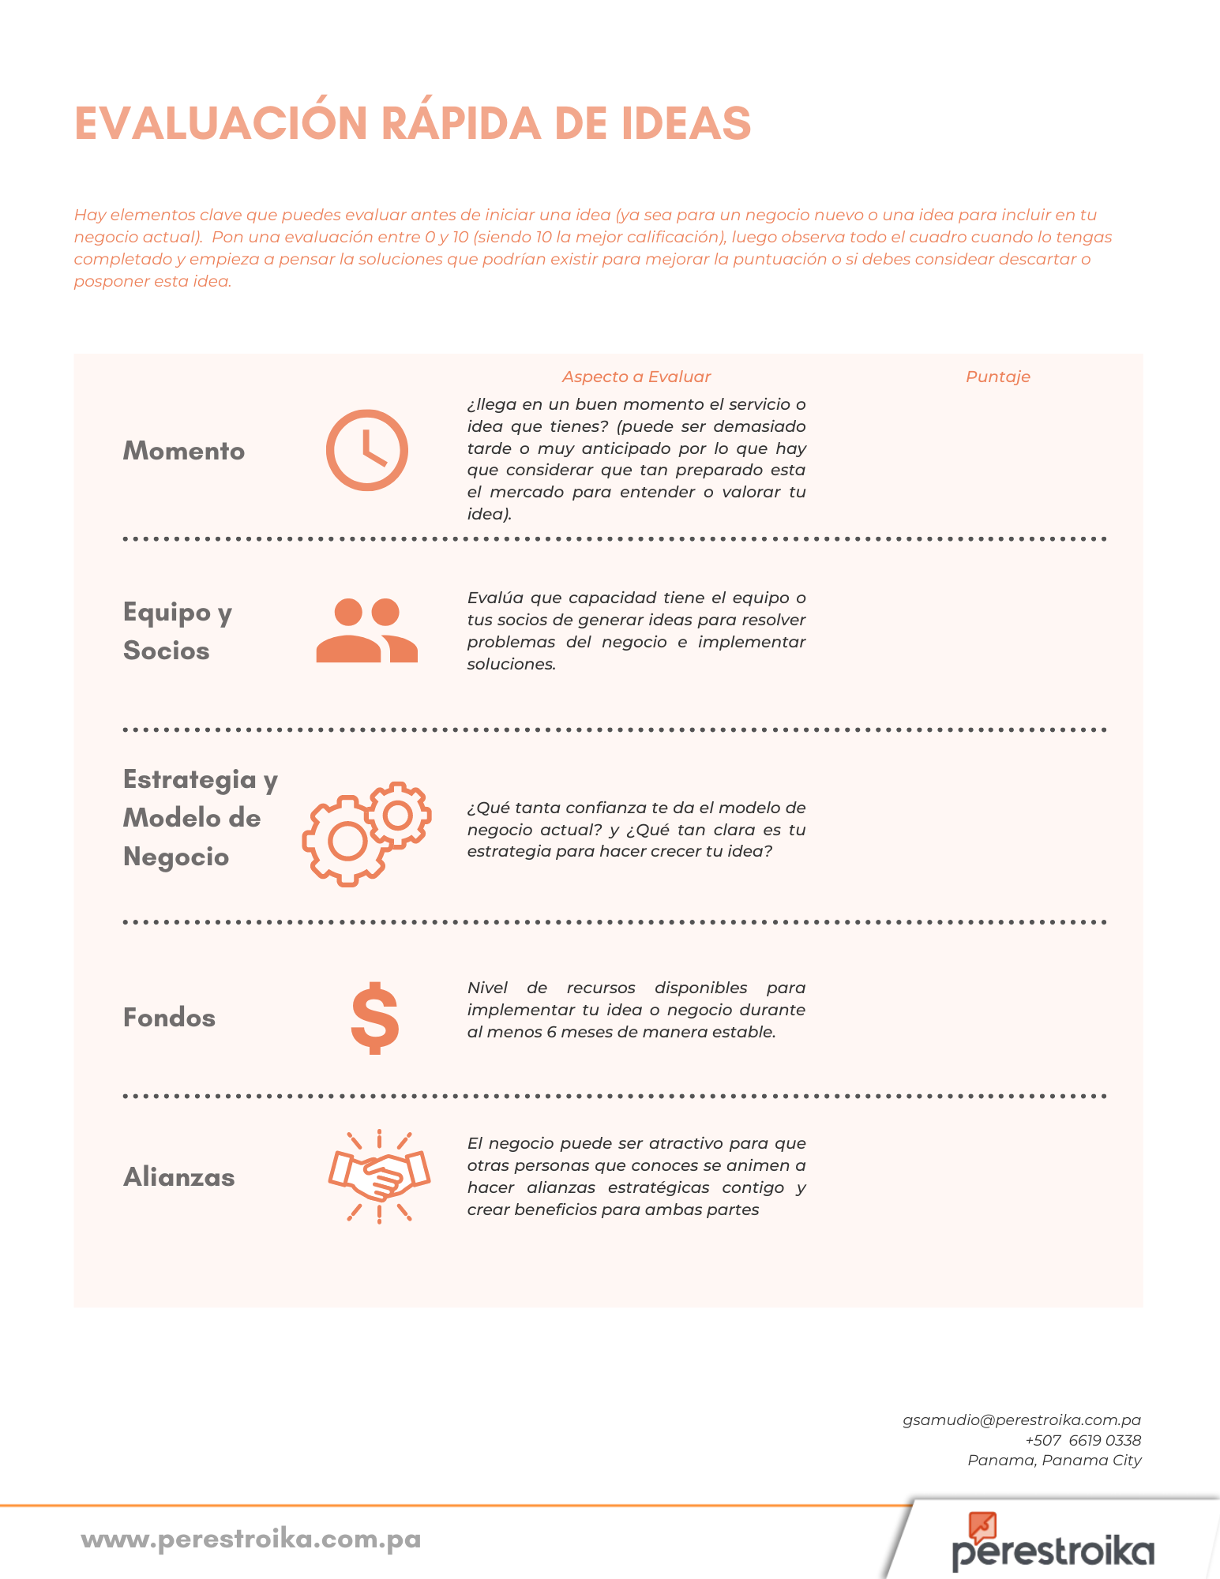
0-10
0-10
0-10
0-10
0-10

